Slide 1
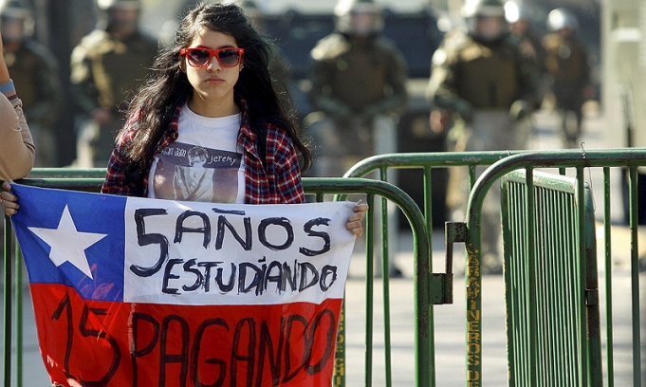
CHILE
Quality Education (Standards)
Free Education
Equity
Inclusion
January 24th. , 2016

Slide 2
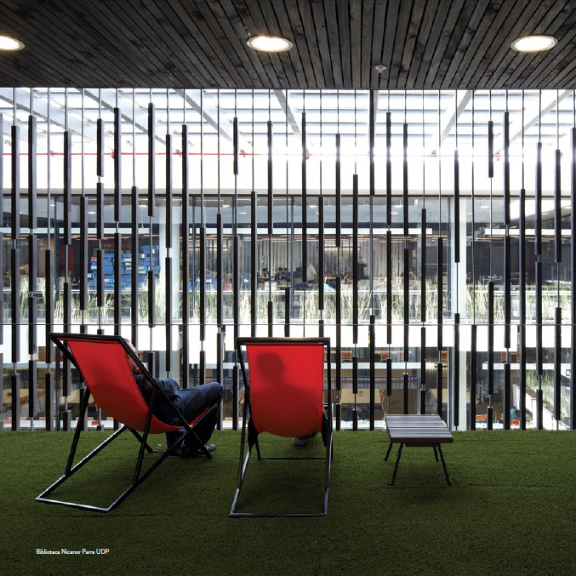

Slide 3
What we do…
…Guarantee a space of freedom and critical independence for its members (autonomy), which refuses any kind of ideological, political or religious affiliation (pluralism) while having a clear and sustained public vocation.
This, along with the focus on quality (excellence) of their activities, are hallmarks of our work.

Slide 5
Faculty of Education
Located in Santiago, Chile Founded in 1983
Internationalization
_{Contextualized in Chile}
Quality of Professional Education
Teaching based on Current Research
Life - long Education

Slide 6
Faculty of Education
Common thread(s)
Practicum: To bridge between schools’& universities’ communities of practice
Human Rights
Equity Diversity / Inclusion

Slide 7
Pedagogy Programs
1. Primary School Pedagogy - 4 year p.
3. Pre-School Pedagogy - 4 year p.
4. Pedagogy in Spanish and Social Science- 1year p.
5. Pedagogy in Special Educationa - 4 year p.
4. Pedagogy in English Language Teaching (ELT) - 4.5 year p.

Slide 9
Primary School Pedagogy
Pedagogical and Content Knowledge & Inclusion
First to 6th Grade
Practicum: 5 Practicum Courses (+ 3 practicum interventions) : Constant reflection (Video recording tool)
Two majors: Language (Spanish) and Math

Slide 10
Pre-School Pedagogy
Content and pedagogical knowledge
0 – 6 year old students
Practicum: Professional Development Schools/ Collaborative realtionship between University and schools / Video recording (interactive platform)
5 Practicum Courses (+ 3 practicum interventions)

Slide 11
Pedagogy in Spanish and Social Science
Previous Degree in History, Geography and Social Science / in Spanish (content knowledge)
Courses aiming at learning to teach (methods, strategies, planning, assessment, etc)
Practicum courses throughout

Slide 12
Pedagogy in Special Education
Human Rights / Diversity / Inclusion
Major in Development of Cognitive Skills
Regular Schools (Ley de Inclusion) & Special Needs School
Content knowledge: Spanish & Math (1st to 6th)
7 Practicum Courses

Slide 13
Pedagogy in English Language Teaching
Key factors underpinning our actions:
Exit Profile ---- Competency-based Curriculum
Integrated Curriculum --- Learning English/ Learning about English/ Learning to teach
(PCK, Lee Shulman)
Critical reflection -- Equity – Constant Researcher
Excellence --- International Exams
Primary, Middle and Secondary School
6 Practicum Courses

Slide 14
