Slide 1
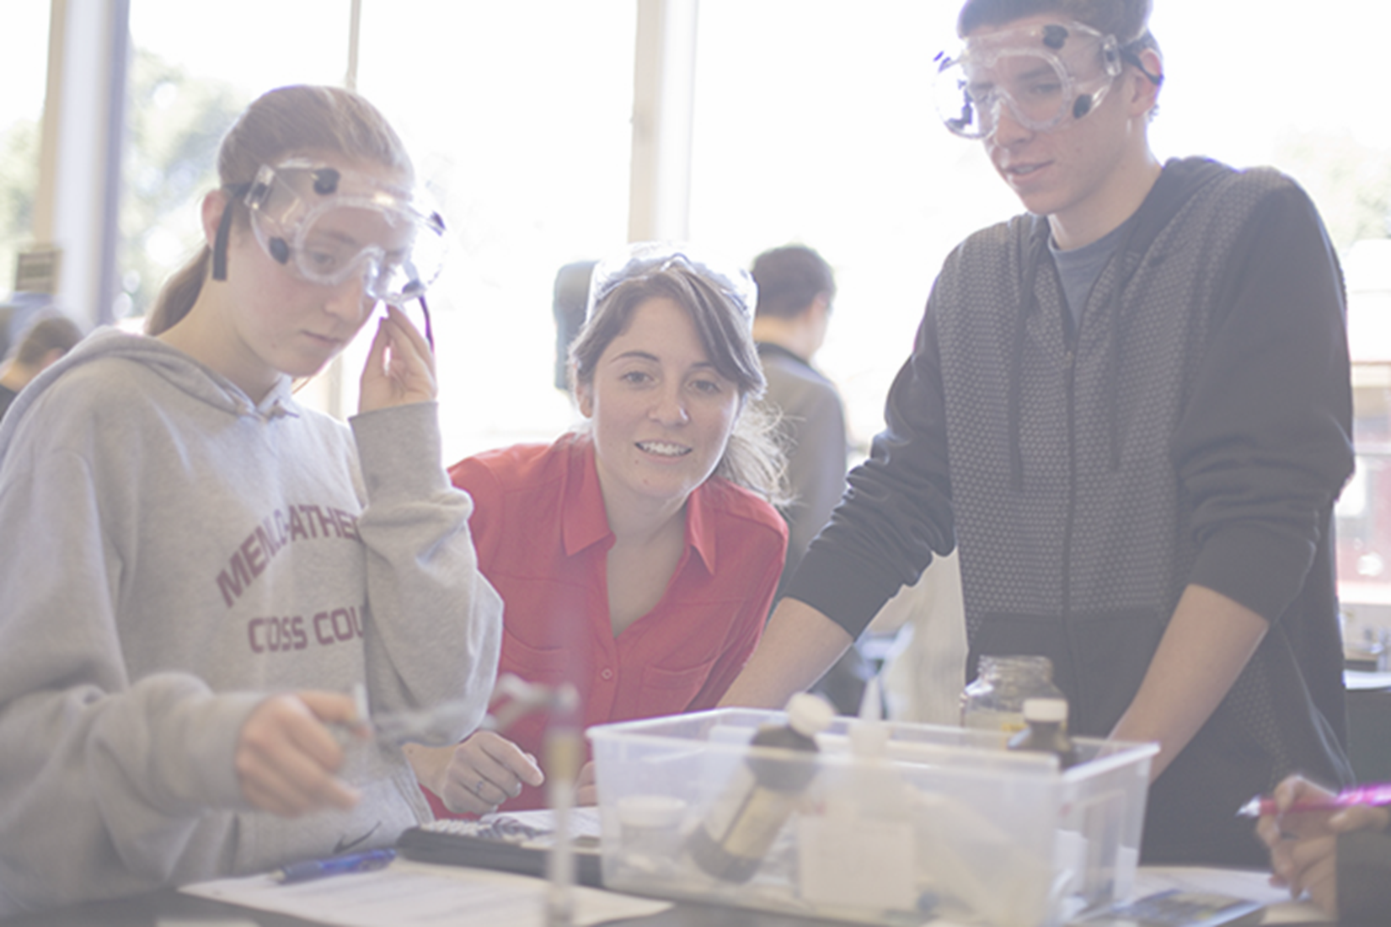
Putting Theory into Practice
Stanford Teacher Education Program
January 25 – January 29, 2016

Slide 2
STEP Olympics
Bronze: Schools with only 1-2 teacher candidates
Silver: Schools with a cohort of teacher candidates
Gold: Partner District
Sunnyvale Elementary School District
Columbia Middle School (UPP)
San Francisco Unified School District (SFTR)

Slide 3
Putting Theory into Practice Going for the Gold!
opportunities to learn and engage in equitable practices.
opportunities to observe high quality teaching.
opportunities to engage with high quality mentors.
Teacher candidates are best supported when their placements and their university-based program (STEP) are a mutually valued partnership.

Slide 4
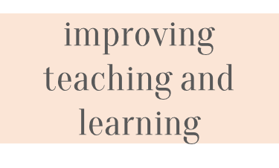
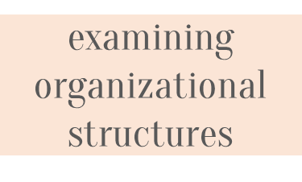
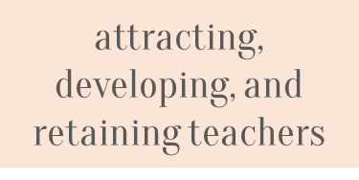
Re-envisioning Council of Partner Schools 2015-2016
Collaboration among a group of K-12 schools and STEP
Mutual Goals

Slide 5
Partners
Partner Schools and STEP have the following characteristics:
A shared commitment to prepare and support teachers to work with all students to achieve intellectually, academically, and socially in equitable schools and classrooms
Engagement in continual efforts to improve teaching and learning for all students and to narrow the achievement gap
The prevalence of academically rigorous curricula, and theoretically and empirically supported pedagogical practices
A professional environment allowing for continuous development of school and university faculty
Geographic proximity to each other

Slide 6
Partner Responsibilities
Create team of administrator(s) and faculty to represent the organization
Participate actively in working sessions
Work collaboratively to support the development of STEP teacher candidates
Host and attend Grand Rounds visits at Partner School sites
Identify schools or institutions who share the characteristics of the current partners

Slide 7
Benefits
have a forum to share common issues and concerns and learn from one another and share resources
are eligible to participate in professional development opportunities sponsored by Stanford
participate in Grand Rounds visits
have the opportunity to conduct research that will inform their practice
STEP teacher candidates can be placed and hired in Partner Schools
Partner Schools

Slide 8
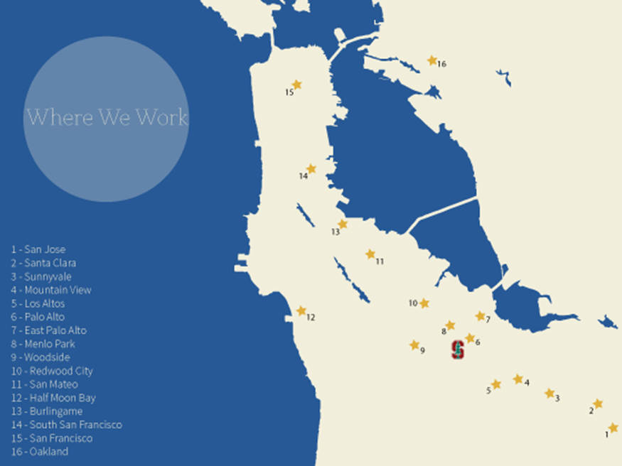
STEP Placements

Slide 9
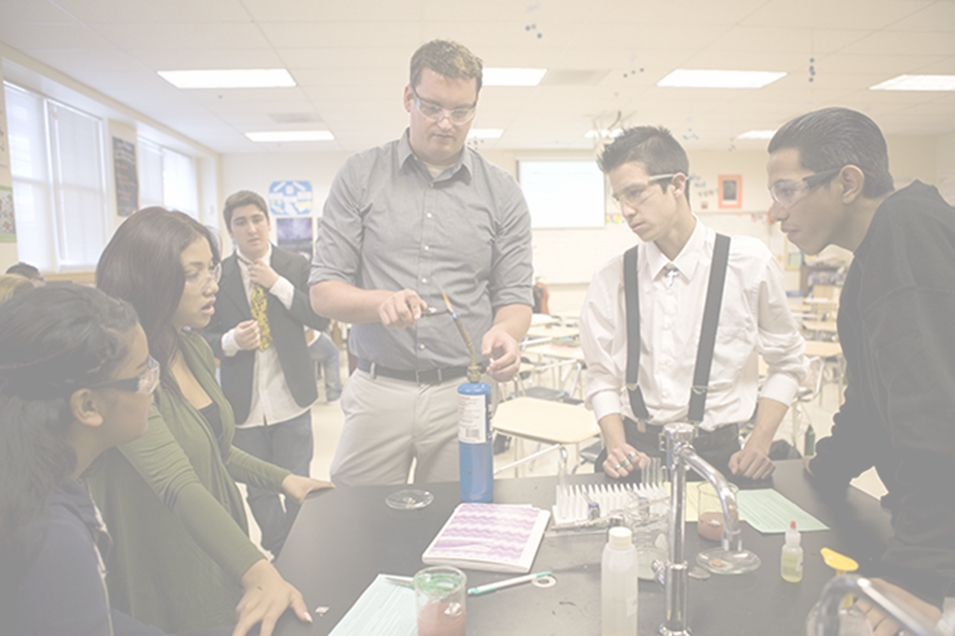
School Visits
Secondary
Hillsdale High School
Mountain View High School
Eastside Palo Alto Academy
June Jordan School for Equity
Sequoia High School
Everest
Luis Valdez Academy
Columbia Middle School
Fremont High School
Elementary
Ponderosa Elementary School
EPACS
Costaño Elementary School

Slide 10
School Websites
https://ed.stanford.edu/step/academics/elementary
https://ed.stanford.edu/step/academics/secondary
School Visit Directions:
Please arrive at Wilbur Field each morning by 8:20 a.m.
Each day we will return to campus by noon

