Slide 1

iSTEP 2016: The Design of STEP
Notes:
PW

Slide 2
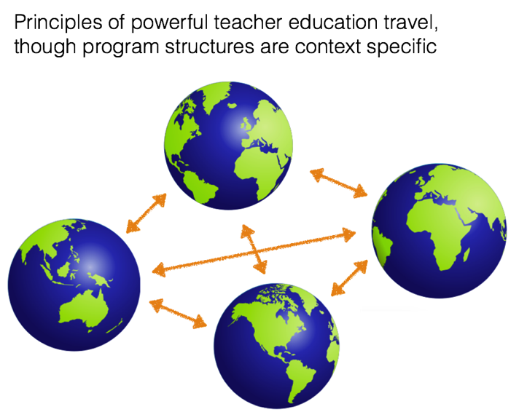
Notes:
PW
STEP as ONE instantiation of principles of PTE in our own local, state and national context…
Hope you’ll see evidence of the principles embedded in our practice in robust ways…
Certainly not perfect…ongoing efforts to innovate, evaluate, revise and replenish, and the contexts of our work are always changing…

Slide 3

The Design of STEP
  Mission and goals
  Key design features
    Cohort model
    Clinically rich
    Research-based curriculum
    Assessment and refinement system
  Impact
  Commitment
Notes:
PW
Share a few key design features with you today.
Lots of opportunity to learn and explore more during the week.

Slide 4
STEP Mission & Goals
STEP: A DEMONSTRATION PROGRAM
Instantiation of principles of powerful teacher education in practice
Virtuous cycle of research and practice informing one another
Preparation of educational leaders
  Teachers for K-12 schools and classrooms
  Teacher educators and scholars of teacher education
Impact, amplification, and dissemination
  Program outcomes, curricular innovations, research contributions
  Leading and shaping conversations in the profession
Notes:
IL
Wanted to begin with our vision for teacher preparation at Stanford:
STEP as a demonstration program:
Strive to serve as a model for what works in teacher preparation
a place where the best of research is put into practice
and, our practice informs the development of scholarship in the field
Work to elevate and promote teaching as a valued profession
and a voice for quality and enhancement for the field
Our outcomes take several forms:
Lives in the work of our exceptional graduates
Evidenced by the scholarly contributions made by our faculty
Has impact well beyond our numbers
Will share more about this later…

Slide 5
STEP Mission & Goals
STEP strives to prepare teachers who can successfully:
  Meet the intellectual and practical demands of the profession
  Serve the needs of today’s population of diverse students equitably and with rigor
  Revitalize and strengthen the profession today by becoming leaders for tomorrow’s schools
Notes:
IL
Understanding the complex nature of exceptional teaching, we strive to prepare educators who can…

Slide 6
STEP Mission & Goals
  STEP aims to cultivate teacher leaders who share a set of core values that includes a commitment to social justice, an understanding of the strengths and needs of a diverse student population, and a dedication to equity and excellence for all students.
  The program takes an approach to teaching and learning that is sensitive to the family, community, and political contexts of education; focused on the needs and development of learning; and grounded in the study of subject matter that enables inquiry, critical thinking, and problem solving.
Notes:
IL
We have a mission statement. We use it to support, inform and drive our work.

Slide 7
Program features
Cohort model
Clinically rich
Content pedagogy
Assessment system
Notes:
PW
Want to share a few key features of our program design.
You’ll have lots of opportunity to learn, explore, inquire further over the course of the week.

Slide 8
Program features
Cohort model
Notes:
PW
COHORT MODEL:
12-month, full-time, intensive program
Leads to a Master of Arts in Education and a California teaching credential (license)
Relatively small cohort (approximately 90-100 candidates)
All students begin the program together and complete the course as a community of learners
Developmental in nature.
We think this adds to coherence

Slide 9
Program features
Clinically rich
Notes:
PW
CLINICALLY RICH:
Extensive teaching experience in the field
summer school in collaboration with partnering district
year-long placements in local public schools
average of 20 hours/week
Close supervision, mentoring
Close partnerships with collaborating schools and teachers

Slide 10
Program features
Content pedagogy
Notes:
PW?
CONTENT PEDAGOGY
Access to top faculty, leading scholars in their field
STEP as a site for innovation; a laboratory for faculty
Academic program closely linked to relevant, current scholarship in the field.
Focused instruction in the academic disciplines

Slide 11
Program features
Assessment system
Notes:
PW?
ASSESSMENTY SYSTEM
Robust assessment system
Ongoing formative assessment of professional growth
Culminating in a set of authentic summative performance assessment
Opportunities for feedback and support
Supports growth for students
Supports refinement of program

Slide 12
STEP Secondary Curriculum
Notes:
PW
Just note that our program curriculum grids are posted on the website.
Good resource for further conversation during the week.
Maybe hightlght a theme or two:
Threads of … content pedagogy (C&I)
Threads of … equity and excellence (both specific coursework: E&S, SSSN, LPP, TLCH, etc. + embedded throughout)

Slide 13
STEP Elementary Curriculum
Notes:
IL

Slide 14
STEP: IN A STUDENT’S WORDS
Notes:
IL
Share a short video of one of our stellar alums, who offers a window into her experience while in STEP
Introduce – Adriana Campos
• Stanford undergraduate, Education Honors
• STEP, Class of 2012
• Current 2nd grade, bilingual teacher at Garfield elementary in Redwood City
• Now a stellar CT! (first year)
• leadership roles at her school already
• equity focused – suspension/office referral issues…

Slide 15
STEP Assessment System
  Reflects STEP goals and related standards
  Includes multiple and varied assessments
    Pre-assessments
    Embedded program assessments
      Evidence of academic achievement in coursework
      Evidence of developing and growing performance in clinical setting
      Evidence of professional conduct
    Summative assessments
      PACT: Performance Assessment of California Teachers
      Graduation Portfolio
      STEP Conference
    Post-graduate assessments
Notes:
IL
Share a bit more detail here about the Assessment system:
UBD approach:
Goal driven
Authentic
Performative
Assessments FOR Learning

Slide 16
STEP Assessment System
Pre-Assessments
  Application materials: academic preparation, experience with youth, professional experience, personal background, commitment to teaching
  Entry surveys: expectations, perspectives, prior experience, clinical preferences and needs
  Personal learning survey
Clinical Work Assessments
  Observation cycles and feedback from mentor teachers and supervisors
  Quarterly assessments based on state standards
  Independent Student Teaching
Coursework Assessments
  Key assignment and projects (typically linked to field placements)
    case studies, classroom management plan, lesson implementation, video analyses, curriculum unit, etc.
  Grades and participation
Summative Assessments
  PACT: Performance Assessment of California Teachers
  Graduation Portfolio
  STEP Conference
Notes:
IL

Slide 17
Outcome Assessments:
Indicators of Program Quality
Notes:
PW
OVERVIEW:
Range of POST-GRAD Assessments: Surveys, Observations (mostly informal), Stanford studies (grad students, faculty), outside studies (Art Levine, CADE), etc.
One example of outcome assessment: from 2012 survey: Graduates stay in the profession through teaching and leadership roles
Across 10 year sample: 87% (nearly 90%) employed in field of education
75% in K-12 classroom teaching positions- very high retention rate
The five year retention rate is nearly 80% (employed in K-12 classroom teaching positions in their fifth year after step) which is strong compared to the national rate, which is more like 50%-60% (or less in urban areas).
And they all get jobs – even in the last 5 years of a challenging economy

Slide 18

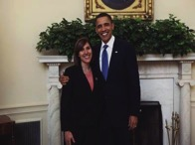

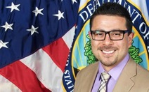


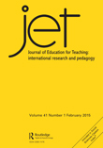
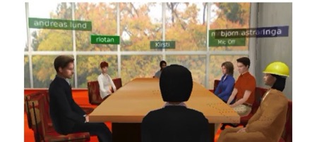
Outcomes: Amplification
EDUCATING
SCHOOL
TEACHERS
BY ARTHUR LEVINE
Notes:
PW
Here we highlight the numerous ways our work is amplified beyond the just the number of exceptional teachers we prepare each year:
Leadership: Graduates take on leadership roles in and beyond the classroom.
• 95% of our alumni report taking on a least one leadership role in their work
• 42% are engaged in school reform
• 22% leading or supporting efforts to start news schools or programs
• 10% are National Board certified (compared with 3% nationally)
Our alumni demonstrate leadership in numerous other ways:
Award winning teachers
Education Advocates:
Teaching Ambassadors, US Dept of Ed, America Achieves fellows
Public Advocates – sr. staff atty.
Teacher educators: professors and doctoral students
2. STEP related research has an impact on the field
Studies published in key research journals contribute to our knowledge base for teaching
Research about teacher education programs often recognizes STEP for excellence and coherence of the model
3. GSE faculty in teacher education have developed curriculum and other resources that have broad reach around the country and the world - too many to list here!
Understanding Language- from Kenji Hakuta’s work with English languge learners
YouCubed- From Jo Boaler’s work on mathematical understanding
Stanford History Education Group- from Sam Wineberg’s groundbreaking work on teaching students to think like historians
Complex Instruction- Elizabeth Cohen and Rachel Lotan’s work on teaching in heterogeneous classrooms
3b. We and our colleagues help to shape state and national policies related to teaching and teacher education
Faculty leadership in key organizations such as AACTE, CCTE, AERA
Involvement of faculty in shaping national policy such as the recent response to the proposed reforms for teacher education programs
4. As a demonstration program, we are helping the international community learn from our model and our experience
iSTEP impact internationally – work with 2 dozen int’l teacher educators annually – that’s you!!
Vicoted – collaboration with the School of Engineering to build an online platform to broaden the reach of these efforts
Launch hubs of collaboration and innovation across the globe
Broadly, STEP and the GSE are sites for innovation, a workshop for developing products with broad impact…

Slide 19
Stanford’s Commitment to Teacher Education
Notes:
PW
• Conclude by noting how fortunate we are to have strong support of our Dean and University president and provost
> This is NOT a given for university-based teacher preparation, particularly in research intensive institutions
• Stanford’s leadership understands the importance of the teaching profession and of our work in teacher preparation here at Stanford
• President Hennessy’s words here, underscores our ambition to some day to make STEP tuition free—demonstrating Stanford’s deep commitment to affordable training of well prepared and committed teacher leaders
IRA – Stanford commitment
• Fortunate to have strong support of our Dean and University president
• Avery gift – loan forgiveness program -- matched by President Hennessey from Presidential Funds
• Hear in his words…

Slide 20

Notes:
IL - END HERE for DISCUSSION

